Slide 1
Network-emulator
Noah Gary & Daniel Salami

Slide 2
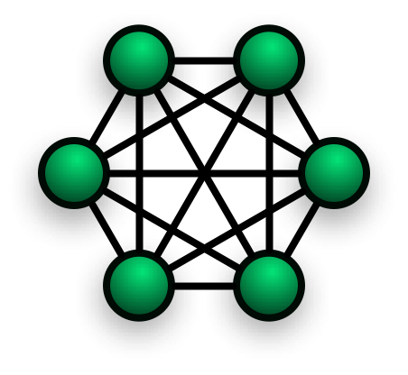
Introduction

Slide 3
Approach
Router
add_neighbor(self, neighbor)
Adds the neighbors information to an array for tracking
drop_neighbor(self, n)
drops a certain neighbor based on the router number
get_address(self)
assigns itself a unique address
update_table(self, table)
Updates the forwarding table for the router
serve(self)
Router that serves as a server for another router.
client(self, neighbor)
Router that serves as a client for the connection.

Slide 4
Approach
Monitor
Spawns Routers and connects them (Creates network)
Keeps track of network in a graph concurrently

Slide 5
Approach
Network Visualization
Uses graph to show network and run dijkstra’s algorithm using networkx and matplotlib libraries
Shows current network

Slide 6
Difficulties
Keeping track of neighbors:
There was an issue with a global neighbors variable
Creating unique ports for each router:
Needed a safe port range and needed extra ports between them for connections
Creating multiple connections:
Getting Unique ports for all of the connections

Slide 7
Solutions
Keeping track of neighbors:
Moved the declaration to __init__() and declared it with “self.neighbors”
Creating unique ports for each router:
Used a multiplier to separate the ports:
BASE_PORT + routerNumber*MULTIPLIER
Creating multiple connections:
Subtracted the number of neighbors from the router’s port giving it up to 9 outgoing connections

Slide 8
Challenges
[ehhh] Challenge 1
The forwarding table is created but not shown in the network visualization
X Challenge 2
Because of our design and time limitations we couldn’t fully implement all functions
✓Challenge 3
The network can propagate data across the network from the client to the server in the form of a message.

Slide 9
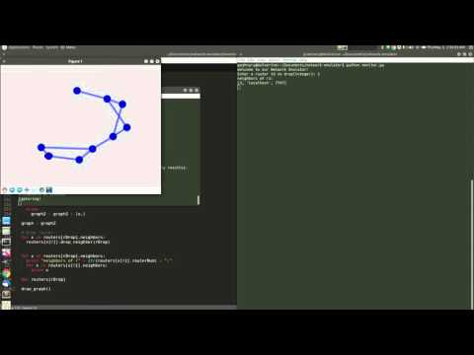
Demo

